Slide 1


Comparing Golang and understanding Java Value Types
Peter Verhas
Software Architect
May 24, 2018 15:55 - 16:40, DevDays Vilnius
Notes:
Title slide with speaker’s photo

Slide 2

I am java programmer, Why should I care?
I have read about ValueTypes in 2015... So what ?
I learned a bit Golang in 2016 and then again Value Types
Ahhh... that’s it!
Go is so much different from Java, we can learn a lot from it
Photo by Les Anderson on Unsplash
Notes:
Key text
photo

Slide 3

DISCLAIMER
I am a Java programmer first
I am a polyglot programmer second
I know Java and Go is only one of the many languages I am not afraid of
I have Swiss Chocolate
Notes:
Key text
photo

Slide 4
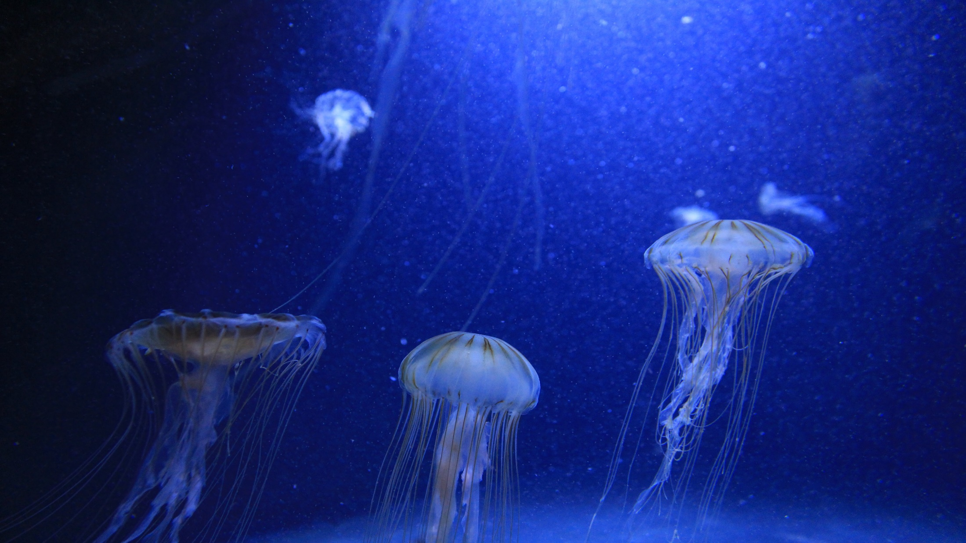

What is the answer to the ultimate question of life,
the universe, and everything ?
Forty-two
Was ist die Antwort nach dem Leben, dem Universum und dem ganzen Rest?
zweiundvierzig
Notes:
Key text
photo

Slide 5
WHY?
4
2
Which is the better?
Notes:
Key text
photo

Slide 6


GO is the language of google
Go is the new C++
Go is a system programming language
Go is genius
Go is terrible
Photo by Henry Hustava on Unsplash
Notes:
Key text
photo

Slide 7
Seriously…
Go is a compiled language source -> exe, no VM
Object oriented and functional
There is a garbage collector but it is not a real garbage collector,
… or is it?
Notes:
Key text
photo

Slide 8
We will talk about
Language syntax
Exception handling (panic)
GC
Local variables and the stack
Closures
Goroutines
Object Orientation and Inheritance
There is
There is not
We only slightly touch these!
This will teach us the most!
Notes:
Key text
photo

Slide 9

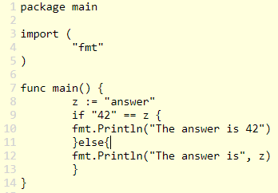
Syntax
mostly C like Java, C#, Perl, ….
BUT
if( a == b )
if a == b {
…
}
var x
:
typeOf
x
= expression
if variable is not used it is an error
if you import a package you do not use it is an error
if you do not use semicolon at the end of the line… go will assume you wanted
Public is written capitalized. Otherwise private.
Notes:
Key text
photo

Slide 10
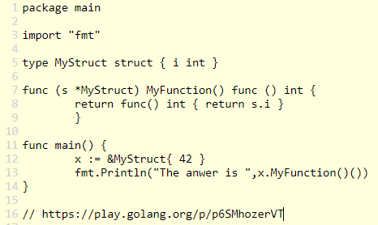
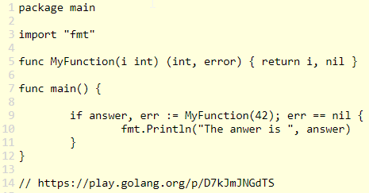
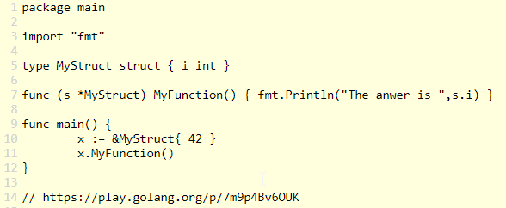
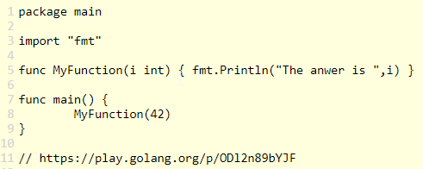
Function definition
There are functions… just function
Methods are also functions with receiver
We just separate the parts with spaces and parentheses
Notes:
https://play.golang.org/p/0hAjISo83w1

Slide 11
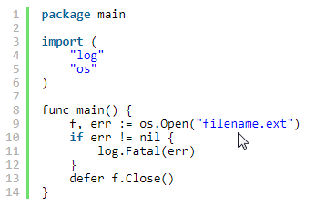
Exception handling
There is no exception handling
Methods return multiple values (like Python), usually result and error status
Panic is like Java throw but should not be used for exceptions, only error
Defer can be used like Java finally
Notes:
Key text
photo

Slide 12
Garbage Collection
For the programmer: there is an automated Garbage Collector
For the hard-core JVM guys: it is not a real GC, there is no compacting
and how objects are stored and managed is a reason for that
Notes:
Key text
photo

Slide 13
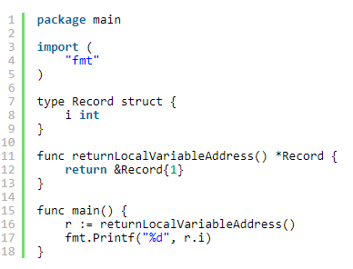
Local variables and the stack
What happens when you return a pointer to a local variable in C?
What happens when you return a pointer to a local variable in Go?
Go will allocate the escaping local variable on the heap.
Notes:
Key text
photo

Slide 14
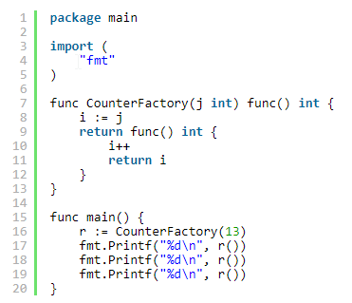
closures
Functions defined inside function
Surrounding is closure
Return a function as result (Go is functional)
Notes:
Key text
photo

Slide 15
goroutines
Goroutines are fibers, lightweight threads.
You can start a few tens of thousands of them, no problem.
There is a built-in type: channel. This is a fixed size FIFO.
Notes:
Key text
photo

Slide 16
Objects in GO
There is interface in GO but this is something different from what it is in Java.
You do not … implements … an interface, you just implement it.
There is a struct type
Struct can not extend other structs but it may contain other structs
Functions may operate on a certain type
Notes:
Key text
photo

Slide 17
Objects in GO
OBJECTS in JAVA
interface
Struct does not „implements”
Struct contains
Function works on a struct type (receiver of the function)
Variables are either struct type or interface type
interface
Class implements interface
Class extends
Method inside class
Variables are either class type or interface type, but it does not matter
Notes:
Key text
photo

Slide 18

Golang „Objects” are headless
Java has ~ 8/16 byte header in front of each object
Golang has struct, no header
Java array → array of references to objects
Go array → array of struct memory
(interface array is array of references)
Notes:
Key text
photo

Slide 19
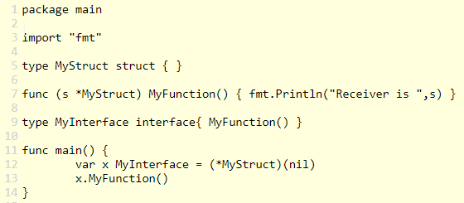
Golang „Objects” are headless
Variables that are struct type hold the value
Variables that are pointer to struct type know what they point to
Variables that are interface type have a reference to the struct and also reference to the struct definition
Let’s have a weird example that will make you understand and remember
Notes:
Key text
photo

Slide 20
And now something completely different
Java value types
Notes:
Key text
photo

Slide 21
What are value types in java?
Project Valhalla started 2014
byte, short, int, long, float, double, char and boolean are value types
Project Valhalla aims user definable value types
Value types are not objects, they hold only the value
Notes:
Key text
photo

Slide 22
Golang struct vs. Java value type
object
object header
interface
struct
value type
Notes:
Key text
photo

Slide 23
Why do we need them?
For example Date is a good candidate to be a value type
Old mistake: object has synchronization lock support (seemed to be a good idea)
Objects occupy the heap, value types are allocated on the stack
Value type arrays are CPU cache friendly
Codes like a class, works like an int!
Notes:
Key text
photo

Slide 24
Consequences
Compare with ==
Value type variable can not be null
Limited or no inheritance
Even if there is inheritance we cannot have polymorphism
Method call pass-by-value
Notes:
Key text
photo

Slide 25
Consequences for JVM
Scala Value Type can be extended (restricted to 1 field)
Languages like Swift, Golang can be effectively compiled to JVM
or not…
Many cases we can stop joking around with off-heap memory mapped files for high performance data intensive application
Notes:
Key text
photo

Slide 26
WHY?
variable
Object data
Object header
Which is the better?
Notes:
Key text
photo

Slide 27

takeaway
Java is good as it is
But it can be and it will be better with value types
Java will always be better
and better
Go, and learn go to be a better (Java) programmer. https://play.golang.org/
Notes:
Key text
photo

Slide 28
THANK YOU
peter@verhas.com, verhas@twitter/github, http://javax0.wordpress.com
Photos are from Unsplash
Notes:
Key text
photo

